Slide 1
Goal Programming and Multiple Objective Optimization (MOLP)
Lecture 11
Chapter 3: Optimization
Institute of Engineering
Asst. Prof. Anita Prajapati, Ph.D.
7 July 2023

Slide 2
Goal Programming and Multiple Objective Optimization
Chapter 7
Spreadsheet Modeling & Decision Analysis:
A Practical Introduction to Management Science, 3e
by Cliff Ragsdale
7-<number>

Slide 3
Introduction
Most of the optimization problems considered to this point have had a single objective.
Often, more than one objective can be identified for a given problem
  Maximize Return or Minimize Risk
  Maximize Profit or Minimize Pollution
These objectives often conflict with one another.
This chapter describes how to deal with such problems.
7-<number>

Slide 4
Goal Programming (GP)
Most LP problems have hard constraints that cannot be violated...
  There are 1,566 labor hours available.
  There is $850,00 available for projects.
In some cases, hard constraints are too restrictive...
  You have a maximum price in mind when buying a car (this is your “goal” or target price).
  If you can’t buy the car for this price you’ll likely find a way to spend more.
We use soft constraints to represent such goals or targets we’d like to achieve.
7-<number>

Slide 5
A Goal Programming Example:
Myrtle Beach Hotel Expansion
Davis McKeown wants to expand the convention center at his hotel in Myrtle Beach, South Carolina.
The types of conference rooms being considered are:
Size (sq ft) Unit Cost
Small 400 $18,000
Medium 750 $33,000
Large 1,050 $45,150
Davis would like to add 5 small, 10 medium and 15 large conference rooms.
He would also like the total expansion to be 25,000 square feet and to limit the cost to $1,000,000.
7-<number>

Slide 6
Defining the Decision Variables
X₁ = number of small rooms to add
X₂ = number of medium rooms to add
X₃ = number of large rooms to add
7-<number>

Slide 7
Defining the Goals
Goal 1: The expansion should include approximately 5 small conference rooms.
Goal 2: The expansion should include approximately 10 medium conference rooms.
Goal 3: The expansion should include approximately 15 large conference rooms.
Goal 4: The expansion should consist of approximately 25,000 square feet.
Goal 5: The expansion should cost approximately $1,000,000.
7-<number>

Slide 8
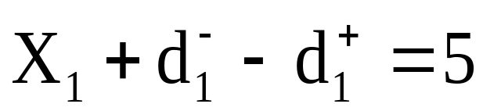
Defining the Goal Constraints
Small Rooms
Medium Rooms
Large Rooms
where
d_{i}⁺ and d_{i}⁻ are deviational variables, represents the amount by which each goal’s target value is overachieved and underachieved respectively
7-<number>

Slide 9
 |  | d⁺ | d⁻
x₁ | 3 | 0 | 2
x₂ | 13 | 3 | 0
x₃ | 15 | 0 | 0
7-<number>

Slide 10
Defining the Goal Constraints (cont’d)
Total Expansion
Total Cost (in $1,000s)
where
7-<number>

Slide 11
GP Objective Functions
There are numerous objective functions we could formulate for a GP problem.
Minimize the sum of the deviations:
  MIN
Problem: The deviations measure different things, so what does this objective represent?
7-<number>

Slide 12
GP Objective Functions (cont’d)
Minimize the sum of percentage deviations
  MIN
  where t_{i} represents the target value of goal i
Problem: Suppose the first goal is underachieved by 1 small room and the fifth goal is overachieved by $20,000.
  We underachieve goal 1 by 1/5=20%
  We overachieve goal 5 by 20,000/1,000,000= 2%
  This implies being $200,000 over budget is just as undesirable as having one too few small rooms.
  Is this true? Only the decision maker can say for sure.
7-<number>

Slide 13
GP Objective Functions (cont’d)
Weights can be used in the previous objectives to allow the decision maker indicate
  desirable vs. undesirable deviations
  the relative importance of various goals
Minimize the weighted sum of deviations
  MIN
Minimize the weighted sum of % deviations
  MIN
w_{i}⁺ and w_{i}⁻ represents numeric values assigned to weight the various deviational variables,
Highly undesirable deviations is assigned a large weight making it undesirable for that variable to assume a value larger than 0
Desirable deviation is assigned weight of 0 or lower than 0
7-<number>

Slide 14
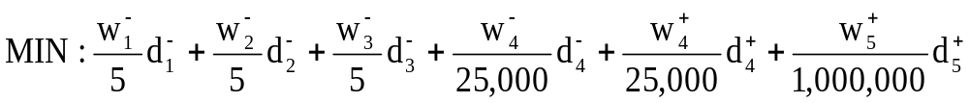
Defining the Objective
Assume
  It is undesirable to underachieve any of the first three room goals
  It is undesirable to overachieve or underachieve the 25,000 sq. ft. expansion goal
  It is undesirable to overachieve the $1,000,000 total cost goal
Initially, we will assume all the above weights equal 1.
7-<number>

Slide 15
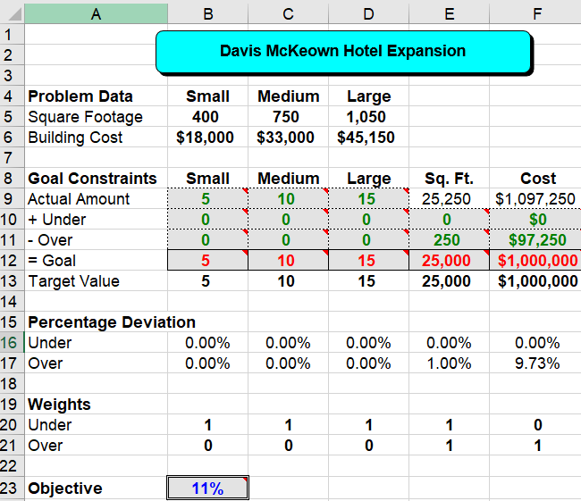
Implementing the Model
Minimize: B23
By changing: B9:D9,B10:F11
Subject to: B12:F12=B13:F13
B9:D9>=0 & integer
B10:F11>=0
7-<number>

Slide 16
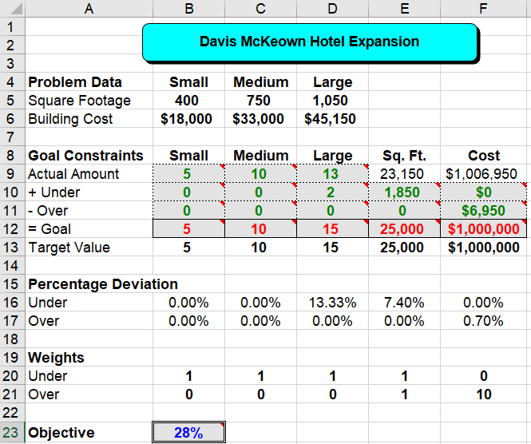
Implementing the Model
See file Fig7-1.xls
Minimize: B23
By changing: B9:D9,B10:F11
Subject to: B12:F12=B13:F13
B9:D9>=0 & integer
B10:F11>=0
7-<number>

Slide 17
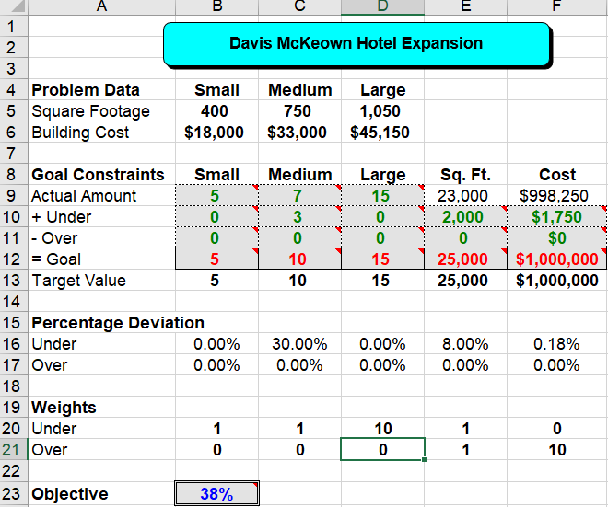
Implementing the Model
Minimize: B23
By changing: B9:D9,B10:F11
Subject to: B12:F12=B13:F13
B9:D9>=0 & integer
B10:F11>=0
7-<number>

Slide 18
Comments About GP
GP involves making trade-offs among the goals until the most satisfying solution is found
GP objective function values should not be compared because the weights are changed in each iteration. Compare the solutions!
An arbitrarily large weight will effectively change a soft constraint to a hard constraint.
Hard constraints can be place on deviational variables.
7-<number>

Slide 19


The MiniMax Objective
Can be used to minimize the maximum deviation from any goal.
MIN: Q
etc...
7-<number>

Slide 20
Summary of Goal Programming
1. Identify the decision variables in the problem.
2. Identify any hard constraints in the problem and formulate them in the usual way.
3. State the goals of the problem along with their target values.
4. Create constraints using the decision variables that would achieve the goals exactly.
5. Transform the above constraints into goal constraints by including deviational variables.
6. Determine which deviational variables represent undesirable deviations from the goals.
7. Formulate an objective that penalizes the undesirable deviations.
8. Identify appropriate weights for the objective.
9. Solve the problem.
10. Inspect the solution to the problem. If the solution is unacceptable, return to step 8 and revise the weights as needed.
7-<number>

Slide 21
Multiple Objective Linear Programming (MOLP)
7-<number>

Slide 22
Multiple Objective Linear Programming (MOLP)
MOLP problem is an LP problem with more than one objective function.
MOLP problems can be viewed as special types of GP problems where we must also determine target values for each goal or objective.
Analyzing these problems effectively also requires that we use the MiniMax objective described earlier.
7-<number>

Slide 23
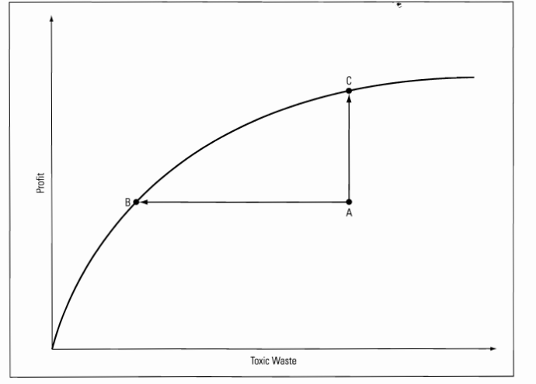
7-<number>

Slide 24
An MOLP Example:
The Blackstone Mining Company
Blackstone Mining operates two coal mines in Southwest Virginia.
Monthly production by a shift workers at each mine is summarized as follows:
Type of Coal Wythe Mine Giles Mine
High-grade 12 tons 4 tons
Medium-grade 4 tons 4 tons
Low-grade 10 tons 20 tons
Cost per month $40,000 $32,000
Gallons of toxic water produced 800 1,250
Life-threatening accidents 0.20 0.45
Blackstone needs to produce 48 more tons of high-grade, 28 more tons of medium-grade, and 100 more tons of low-grade coal.
7-<number>

Slide 25
Defining the Decision Variables
X₁ = number of months to schedule an extra shift at the Wythe county mine
X₂ = number of months to schedule an extra shift at the Giles county mine
7-<number>

Slide 26
Defining the Objective
There are three objectives:
  Min: $40 X₁ + $32 X₂ } Production costs
  Min: 800 X₁ + 1250 X₂ } Toxic water
  Min: 0.20 X₁ + 0.45 X₂ } Accidents
7-<number>

Slide 27
Defining the Constraints
High-grade coal required
  12 X₁ + 4 X₂ >= 48
Medium-grade coal required
  4 X₁ + 4 X₂ >= 28
Low-grade coal required
  10 X₁ + 20 X₂ >= 100
Non-negativity conditions
  X₁, X₂ >= 0
7-<number>

Slide 28
Handling Multiple Objectives
If the objectives had target values we could treat them like the following goals:
Goal 1: The total cost of productions cost should be approximately t₁.
Goal 2: The amount of toxic water produce should be approximately t₂.
Goal 3: The number of life-threatening accidents should be approximately t₃.
We can solve 3 separate LP problems, independently optimizing each objective, to find values for t₁, t₂ and t₃.
7-<number>

Slide 29
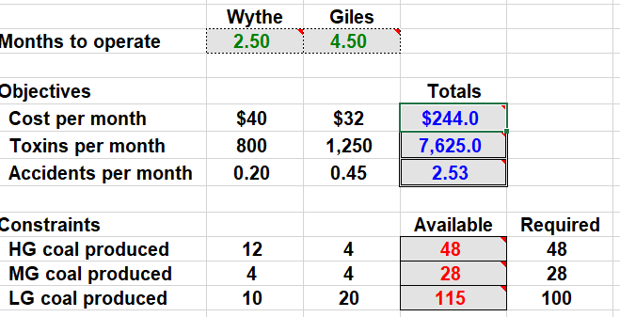
Implementing the Model
See file Fig7-7.xls
Minimize Cost
7-<number>

Slide 30
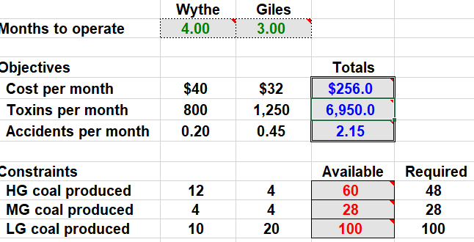
Minimize Toxins
7-<number>

Slide 31
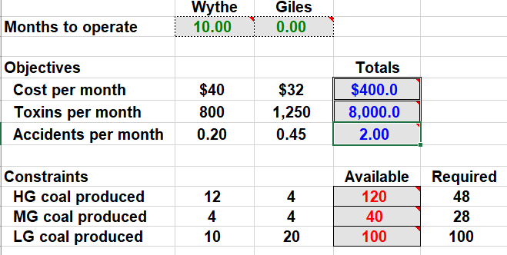
Minimize accident
7-<number>

Slide 32
Summarizing the Solutions
X₂
12
11
Feasible Region
10
9
8
7
6
Solution 1
(minimum production cost)
5
Solution 2
(minimum toxic water)
4
3
2
Solution 3
(minimum accidents)
1
0
X₁
0
1
2
3
4
5
6
7
8
9
10
11
12
X₁
Solution X₁ X₂ Cost Toxic Water Accidents
1 2.5 4.5 $244 7,625 2.53
2 4.0 3.0 $256 6,950 2.15
3 10.0 0.0 $400 8,000 2.00
7-<number>

Slide 33
Defining The Goals
Goal 1: The total cost of productions cost should be approximately $244.
Goal 2: The gallons of toxic water produce should be approximately 6,950.
Goal 3: The number of life-threatening accidents should be approximately 2.0.
7-<number>

Slide 34
Defining an Objective
Formulate GP objective to allow decision maker to explore possible solutions
We can minimize the sum of % deviations as follows:
It can be shown that this is just a linear combination of the decision variables.
This objective will only generate solutions at the corner points of the feasible region (no matter what weights are used).
7-<number>

Slide 35
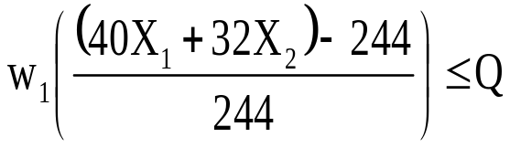
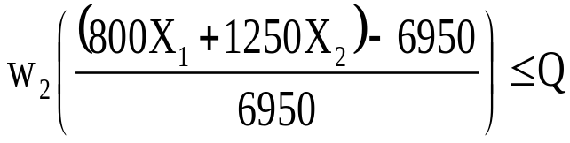
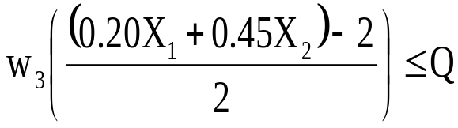
Defining a Better Objective
MIN: Q
Subject to the additional constraints:
This objective will allow the decision maker to explore non-corner point solutions of the feasible region.
7-<number>

Slide 36
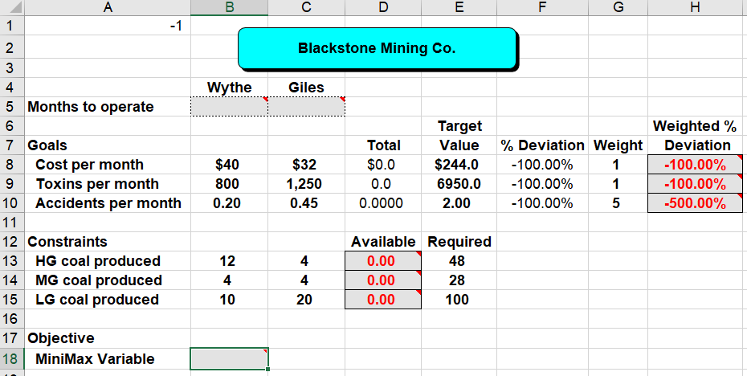
Minimize: B18
By changing: B5:C5 & B18
Subject to: D13:D15.>=E13:E15
B5:C5>=0
H8:H10<=B18
7-<number>

Slide 37
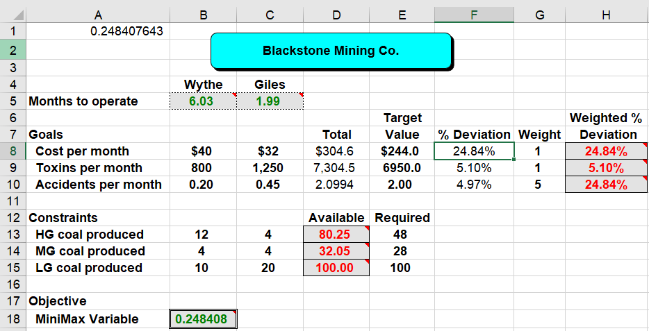
Implementing the Model
See file Fig7-13.xls
Minimize: B18
By changing: B5:C5 & B18
Subject to: D13:D15.>=E13:E15
B5:C5>=0
H8:H10<=B18
7-<number>

Slide 38
Possible MiniMax Solutions
X₂
12
11
Feasible Region
10
9
8
7
6
w₁=10, w₂=1, w₃=1, x₁=3.08, x₂=3.92
5
4
w₁=1, w₂=10, w₃=1, x₁=4.23, x₂=2.88
3
2
1
w₁=1, w₂=1, w₃=10, x₁=7.14, x₂=1.43
0
X₁
X₁
0
1
2
3
4
5
6
7
8
9
10
11
12
7-<number>

Slide 39
Comments About MOLP
Solutions obtained using the MiniMax objective are Pareto Optimal.
Deviational variables and the MiniMax objective are also useful in a variety of situations not involving MOLP or GP.
For minimization objectives the percentage deviation is: (actual - target)/target
For maximization objectives the percentage deviation is: (target - actual)/target
If a target value is zero, use the weighted deviations rather than weighted % deviations.
7-<number>

Slide 40
Summary of MOLP
1. Identify the decision variables in the problem.
2. Identify the objectives in the problem and formulate them in the usual way.
3. Identify the constraints in the problem and formulate them in the usual way.
4. Solve the problem once for each of the objectives identified in step 2 to determine the optimal value of each objective.
5. Restate the objectives as goals using the optimal objective values identified in step 4 as the target values.
6. For each goal, create a deviation function that measures the amount by which any given solution fails to meet the goal (either as an absolute or a percentage).
7. For each of the deviation functions identified in step 6, assign a weight to the deviation function and create a constraint that requires the value of the weighted deviation function to be less than the MINIMAX variable Q.
8. Solve the resulting problem with the objective of minimizing Q.
9. Inspect the solution to the problem. If the solution is unacceptable, adjust the weights in step 7 and return to step 8.
7-<number>

Slide 41
Assignment 6
Question No. : 10, 11, 13, 16, 17,18,19, 23
Assignment-6 due on Wednesday 19th July 2023
7-<number>

Slide 42
End of Chapter 7
7-<number>

